Slide 1
Pipeline & Pipeline Hazards
Dr. Bernard Chen Ph.D.
University of Central Arkansas

Slide 2
Parallel processing
A parallel processing system is able to perform concurrent data processing to achieve faster execution time
The system may have two or more ALUs and be able to execute two or more instructions at the same time
Goal is to increase the throughput – the amount of processing that can be accomplished during a given interval of time

Slide 3
Parallel processing classification
Single instruction stream, single data stream – SISD
Single instruction stream, multiple data stream – SIMD
Multiple instruction stream, single data stream – MISD
Multiple instruction stream, multiple data stream – MIMD

Slide 4
Single instruction stream, single data stream – SISD
Single control unit, single computer, and a memory unit
Instructions are executed sequentially. Parallel processing may be achieved by means of multiple functional units or by pipeline processing

Slide 5
Single instruction stream, multiple data stream – SIMD
Represents an organization that includes many processing units under the supervision of a common control unit.
Includes multiple processing units with a single control unit. All processors receive the same instruction, but operate on different data.

Slide 6
Multiple instruction stream, single data stream – MISD
Theoretical only
processors receive different instructions, but operate on the same data.

Slide 7
Multiple instruction stream, multiple data stream – MIMD
A computer system capable of processing several programs at the same time.
Most multiprocessor and multicomputer systems can be classified in this category

Slide 8
Pipelining: Laundry Example
Small laundry has one washer, one dryer and one operator, it takes 90 minutes to finish one load:
  Washer takes 30 minutes
  Dryer takes 40 minutes
  “operator folding” takes 20 minutes
A
B
C
D

Slide 9
Sequential Laundry
6 PM
7
8
9
10
11
Midnight
Time
30
40
20
30
40
20
30
40
20
30
40
20
T
a
s
k
O
r
d
e
r
A
B
C
90 min
D
This operator scheduled his loads to be delivered to the laundry every 90 minutes which is the time required to finish one load. In other words he will not start a new task unless he is already done with the previous task
The process is sequential. Sequential laundry takes 6 hours for 4 loads

Slide 10
Efficiently scheduled laundry: Pipelined Laundry
Operator start work ASAP
6 PM
7
8
9
10
11
Midnight
Time
30
40
40
40
40
20
T
a
s
k
O
r
d
e
r
40
40
40
A
B
C
D
Another operator asks for the delivery of loads to the laundry every 40 minutes!?.
Pipelined laundry takes 3.5 hours for 4 loads

Slide 11
Pipelining Facts
Multiple tasks operating simultaneously
Pipelining doesn’t help latency of single task, it helps throughput of entire workload
Pipeline rate limited by slowest pipeline stage
Potential speedup = Number of pipe stages
Unbalanced lengths of pipe stages reduces speedup
Time to “fill” pipeline and time to “drain” it reduces speedup
6 PM
7
8
9
Time
T
a
s
k
O
r
d
e
r
30
40
40
40
40
20
A
B
C
The washer waits for the dryer for 10 minutes
D

Slide 12
9.2 Pipelining
Decomposes a sequential process into segments.
Divide the processor into segment processors each one is dedicated to a particular segment.
Each segment is executed in a dedicated segment-processor operates concurrently with all other segments.
Information flows through these multiple hardware segments.

Slide 13
9.2 Pipelining
Instruction execution is divided into k segments or stages
  Instruction exits pipe stage k-1 and proceeds into pipe stage k
  All pipe stages take the same amount of time; called one processor cycle
  Length of the processor cycle is determined by the slowest pipe stage
  k segments

Slide 14
SPEEDUP
Consider a k-segment pipeline operating on n data sets. (In the above example, k = 3 and n = 4.)
It takes k clock cycles to fill the pipeline and get the first result from the output of the pipeline.
After that the remaining (n - 1) results will come out at each clock cycle.
It therefore takes (k + n - 1) clock cycles to complete the task.

Slide 15
Example
A non-pipeline system takes 100ns to process a task;
the same task can be processed in a FIVE-segment pipeline into 20ns, each
Determine how much time does it required to finish 10 tasks?

Slide 16
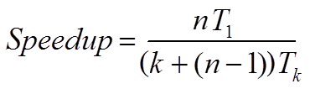
SPEEDUP
If we execute the same task sequentially in a single processing unit, it takes (k * n) clock cycles.
The speedup gained by using the pipeline is:

Slide 17
Example
A non-pipeline system takes 100ns to process a task;
the same task can be processed in a FIVE-segment pipeline into 20ns, each
Determine the speedup ratio of the pipeline for 1000 tasks?

Slide 18
5-Stage Pipelining
S1
S2
S3
S4
S5
Fetch
Instruction
(FI)
Decode
Instruction
(DI)
Fetch
Operand
(FO)
Execution
Instruction
(EI)
Write
Operand
(WO)
Time
S1
1
2
3
4
5
6
7
8
9
S2
1
2
3
4
5
6
7
8
S3
1
2
3
4
5
6
7
S4
1
2
3
4
5
6
S5
1
2
3
4
5

Slide 19
Example Answer
Speedup Ratio for 1000 tasks:
100*1000 / (5 + 1000 -1)*20 = 4.98

Slide 20
Example
A non-pipeline system takes 100ns to process a task;
the same task can be processed in a six-segment pipeline with the time delay of each segment in the pipeline is as follows 20ns, 25ns, 30ns, 10ns, 15ns, and 30ns.
Determine the speedup ratio of the pipeline for 10, 100, and 1000 tasks. What is the maximum speedup that can be achieved?

Slide 21
Example Answer
Speedup Ratio for 10 tasks:
  100*10 / (6+10-1)*30 = 2.222222
Speedup Ratio for 100 tasks:
  100*100 / (6+100-1)*30 = 3.174
Speedup Ratio for 1000 tasks:
  100*1000 / (6+1000-1)*30 = 3.316
Maximum Speedup:
  100*N/ (6+N-1)*30 = 10/3 = 3.333333

Slide 22
Some definitions
Pipeline: is an implementation technique where multiple instructions are overlapped in execution.
Pipeline stage: The computer pipeline is to divide instruction processing into stages.
  Each stage completes a part of an instruction and loads a new part in parallel.

Slide 23
Some definitions
Throughput of the instruction pipeline is determined by how often an instruction exits the pipeline. Pipelining does not decrease the time for individual instruction execution. Instead, it increases instruction throughput.
Machine cycle . The time required to move an instruction one step further in the pipeline. The length of the machine cycle is determined by the time required for the slowest pipe stage.

Slide 24
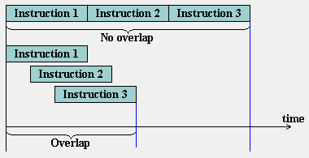
Instruction pipeline versus sequential processing
sequential processing
Instruction pipeline

Slide 25
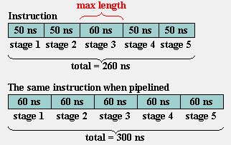
Instruction pipeline (Contd.)
sequential processing is
faster for few instructions

Slide 27
Instructions seperate
1. Fetch the instruction
2. Decode the instruction
3. Fetch the operands from memory
4. Execute the instruction
5. Store the results in the proper place

Slide 28
5-Stage Pipelining
S1
S2
S3
S4
S5
Fetch
Instruction
(FI)
Decode
Instruction
(DI)
Fetch
Operand
(FO)
Execution
Instruction
(EI)
Write
Operand
(WO)
Time
S1
1
2
3
4
5
6
7
8
9
S2
1
2
3
4
5
6
7
8
S3
1
2
3
4
5
6
7
S4
1
2
3
4
5
6
S5
1
2
3
4
5

Slide 29
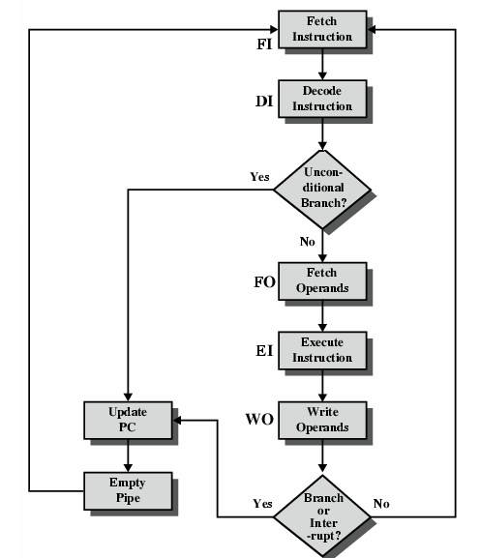
Five Stage
Instruction Pipeline
Fetch instruction
Decode instruction
Fetch operands
Execute instructions
Write result

Slide 30
Difficulties...
If a complicated memory access occurs in stage 1, stage 2 will be delayed and the rest of the pipe is stalled.
If there is a branch, if.. and jump, then some of the instructions that have already entered the pipeline should not be processed.
We need to deal with these difficulties to keep the pipeline moving

Slide 31
Pipeline Hazards
There are situations, called hazards, that prevent the next instruction in the instruction stream from executing during its designated cycle
There are three classes of hazards
  Structural hazard
  Data hazard
  Branch hazard

Slide 32
Pipeline Hazards
Structural hazard
  Resource conflicts when the hardware cannot support all possible combination of instructions simultaneously
Data hazard
  An instruction depends on the results of a previous instruction that has not yet exited pipeline
Branch hazard
  Instructions that change the PC

Slide 33
Structural hazard
Some pipeline processors have shared a single-memory pipeline for data and instructions

Slide 34
Structural hazard
Memory data fetch requires on FI and FO
S1
S2
S3
S4
S5
Fetch
Instruction
(FI)
Decode
Instruction
(DI)
Fetch
Operand
(FO)
Execution
Instruction
(EI)
Write
Operand
(WO)
Time
S1
1
2
3
4
5
6
7
8
9
S2
1
2
3
4
5
6
7
8
S3
1
2
3
4
5
6
7
S4
1
2
3
4
5
6
S5
1
2
3
4
5

Slide 35


Slide 36
Structural hazard
To solve this hazard, we “stall” the pipeline until the resource is freed
A stall is commonly called pipeline bubble, since it floats through the pipeline taking space but carry no useful work

Slide 37
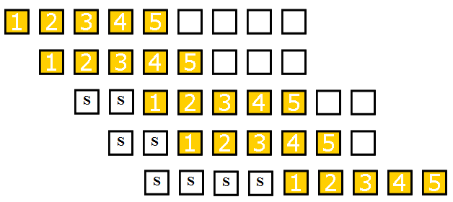
Structural hazard
Fetch
Instruction
(FI)
Decode
Instruction
(DI)
Fetch
Operand
(FO)
Execution
Instruction
(EI)
Write
Operand
(WO)
Time

Slide 38
Data hazard
Example:
ADD R1←R2+R3
SUB R4←R1-R5
AND R6←R1 AND R7
OR R8←R1 OR R9
XOR R10←R1 XOR R11

Slide 39
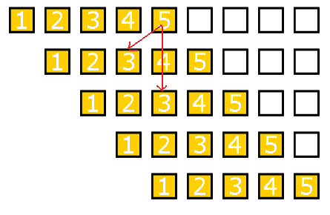
Data hazard
FO: fetch data value WO: store the executed value
S1
S2
S3
S4
S5
Fetch
Instruction
(FI)
Decode
Instruction
(DI)
Fetch
Operand
(FO)
Execution
Instruction
(EI)
Write
Operand
(WO)
Time

Slide 40
Data hazard
Delay load approach inserts a no-operation instruction to avoid the data conflict
ADD R1←R2+R3
No-op
No-op
SUB R4←R1-R5
AND R6←R1 AND R7
OR R8←R1 OR R9
XOR R10←R1 XOR R11

Slide 41
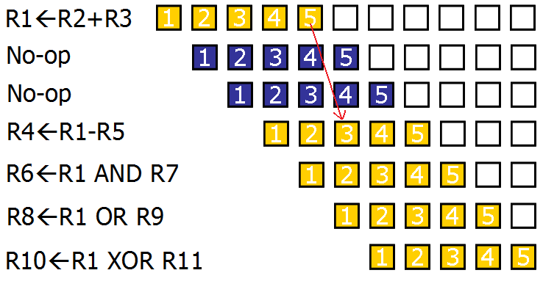
Data hazard

Slide 42
Data hazard
It can be further solved by a simple hardware technique called forwarding (also called bypassing or short-circuiting)
The insight in forwarding is that the result is not really needed by SUB until the ADD execute completely
If the forwarding hardware detects that the previous ALU operation has written the register corresponding to a source for the current ALU operation, control logic selects the results in ALU instead of from memory

Slide 43
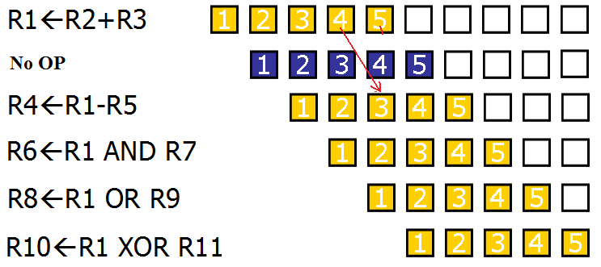
Data hazard Hardware forwarding saves one cycle

Slide 45
Branch hazards
Branch hazards can cause a greater performance loss for pipelines
When a branch instruction is executed, it may or may not change the PC
If a branch changes the PC to its target address, it is a taken branch
Otherwise, it is untaken

Slide 46
Branch hazards
There are FOUR schemes to handle branch hazards
  Freeze scheme
  Predict-untaken scheme
  Predict-taken scheme
  Delayed branch

Slide 47
5-Stage Pipelining
Fetch
Instruction
(FI)
Decode
Instruction
(DI)
Fetch
Operand
(FO)
Execution
Instruction
(EI)
Write
Operand
(WO)
Time
S1
1
2
3
4
5
6
7
8
9
S2
1
2
3
4
5
6
7
8
S3
1
2
3
4
5
6
7
S4
1
2
3
4
5
6
S5
1
2
3
4
5

Slide 48
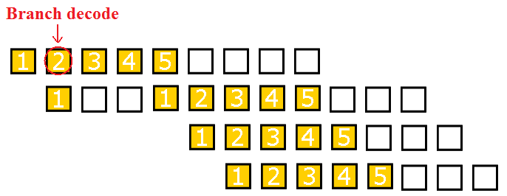
Branch Untaken
(Freeze approach)
The simplest method of dealing with branches is to redo the fetch following a branch
Fetch
Instruction
(FI)
Decode
Instruction
(DI)
Fetch
Operand
(FO)
Execution
Instruction
(EI)
Write
Operand
(WO)

Slide 49
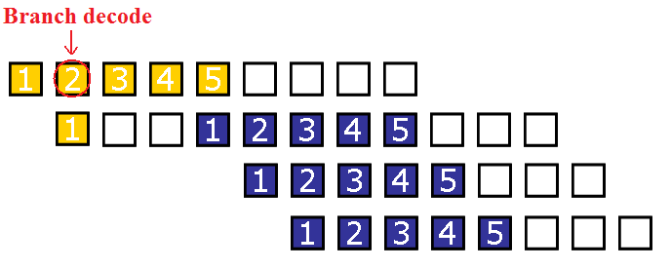
Branch Taken
(Freeze approach)
The simplest method of dealing with branches is to redo the fetch following a branch
Fetch
Instruction
(FI)
Decode
Instruction
(DI)
Fetch
Operand
(FO)
Execution
Instruction
(EI)
Write
Operand
(WO)

Slide 50
Branch Taken
(Freeze approach)
The simplest scheme to handle branches is to freeze the pipeline holding or deleting any instructions after the branch until the branch destination is known
The attractiveness of this solution lies primarily in its simplicity both for hardware and software

Slide 51
Branch Hazards
(Predicted-untaken)
A higher performance, and only slightly more complex, scheme is to treat every branch as not taken
It is implemented by continuing to fetch instructions as if the branch were normal instruction
The pipeline looks the same if the branch is not taken
If the branch is taken, we need to redo the fetch instruction

Slide 52
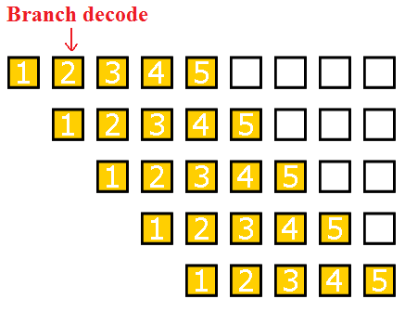
Branch Untaken
(Predicted-untaken)
Fetch
Instruction
(FI)
Decode
Instruction
(DI)
Fetch
Operand
(FO)
Execution
Instruction
(EI)
Write
Operand
(WO)
Time

Slide 53
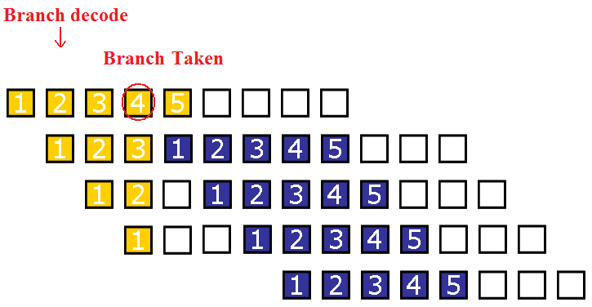
Branch Taken
(Predicted-untaken)
Fetch
Instruction
(FI)
Decode
Instruction
(DI)
Fetch
Operand
(FO)
Execution
Instruction
(EI)
Write
Operand
(WO)

Slide 54
Branch Taken
(Predicted-taken)
An alternative scheme is to treat every branch as taken
As soon as the branch is decoded and the target address is computed, we assume the branch to be taken and begin fetching and executing the target

Slide 55
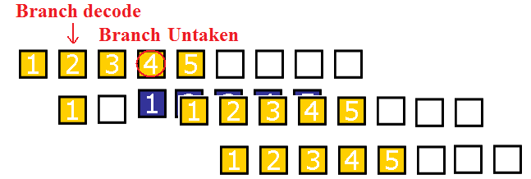
Branch Untaken
(Predicted-taken)
Fetch
Instruction
(FI)
Decode
Instruction
(DI)
Fetch
Operand
(FO)
Execution
Instruction
(EI)
Write
Operand
(WO)

Slide 56
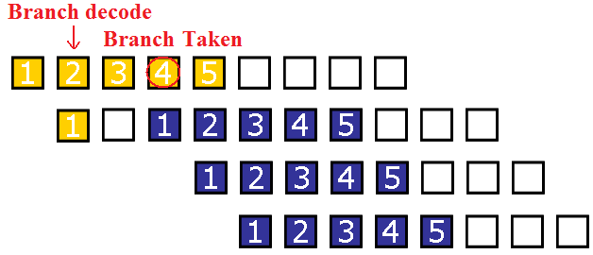
Branch taken
(Predicted-taken)
Fetch
Instruction
(FI)
Decode
Instruction
(DI)
Fetch
Operand
(FO)
Execution
Instruction
(EI)
Write
Operand
(WO)

Slide 57
Delayed Branch
A fourth scheme in use in some processors is called delayed branch
It is done in compiler time. It modifies the code
The general format is:
branch instruction
Delay slot
branch target if taken

Slide 58
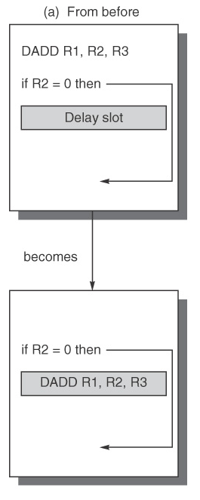
Delayed Branch
Optimal

Slide 59
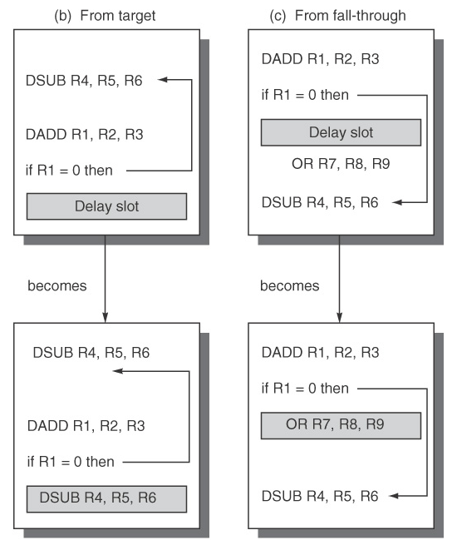
Delayed
Branch
If the optimal is not available:
(b) Act like
predict-taken
(in complier way)
(c) Act like
predict-untaken
(in complier way)

Slide 60
Delayed Branch
Delayed Branch is limited by
  (1) the restrictions on the instructions that are scheduled into the delay slots (for example: another branch cannot be scheduled)
  (2) our ability to predict at compile time whether a branch is likely to be taken or not (hard to choose (b) or (c))

Slide 61
Branch Prediction
A pipeline with branch prediction uses some additional logic to guess the outcome of a conditional branch instruction before it is executed

Slide 62
Branch Prediction
Various techniques can be used to predict whether a branch will be taken or not:
  Prediction never taken
  Prediction always taken
  Prediction by opcode
  Branch history table
The first three approaches are static: they do not depend on the execution history up to the time of the conditional branch instruction. The last approach is dynamic: they depend on the execution history.

